Slide 1
Defense Contract Tracking
Brock Rose

Slide 2
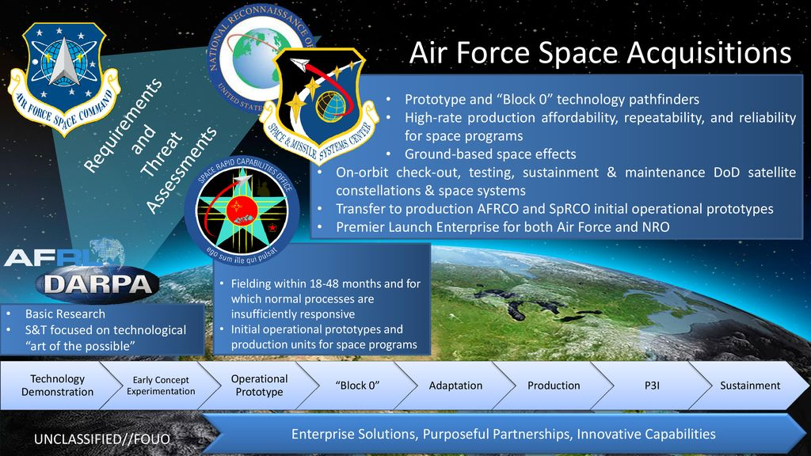
Scope
Align Department of Defense customer hierarchy to internal Customer Relationship Management(CRM) definition
Track budgets and contract/grants to create account portfolios
Extract competitive intelligence (CI) and populate interactive dashboard within CRM account profiles

Slide 3





Defining data
Collecting Contract Data
Four sources of contract/grant data
betaSAM.gov
DACIS
SBIR
Freedom of Information Act
Microsoft Dynamics CRM
Account Profiles
Stakeholder Profiles
100K+ Awards
50K+ Contractors
15K+ Awards
500 Contractors
Grants
Collect Data
Clean/Disambiguate
Associate to Account
Research Labs
SDA
MDA
ONR

Slide 4
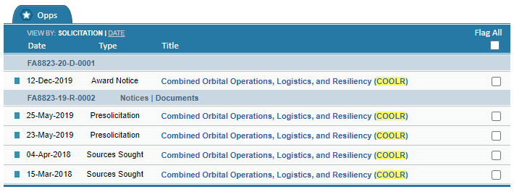


Types of Data
Sources Sought
Pre-Solicitation
Request for Information (RFI)
White Papers
Request for Proposal (RFP)
Award Notice
Contract Details
API

Slide 5
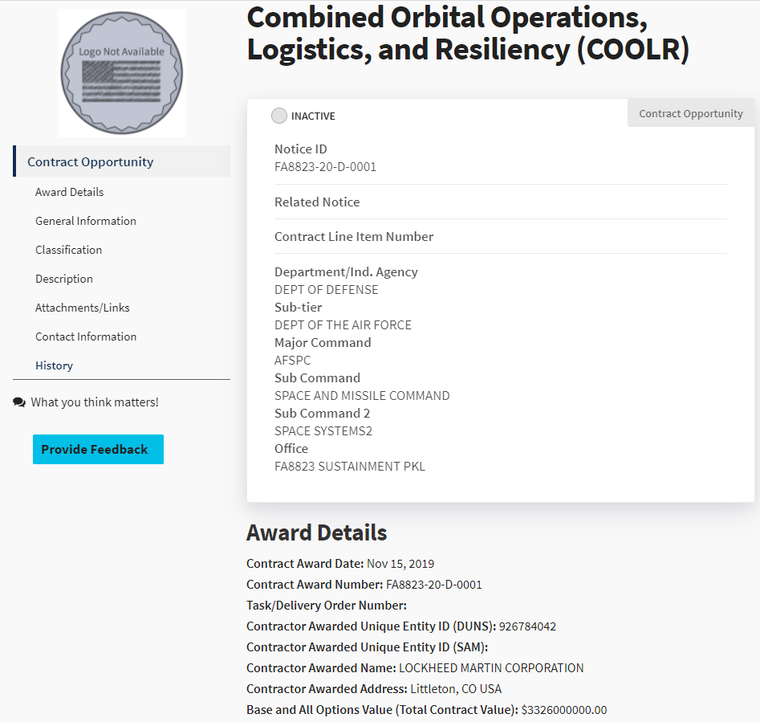
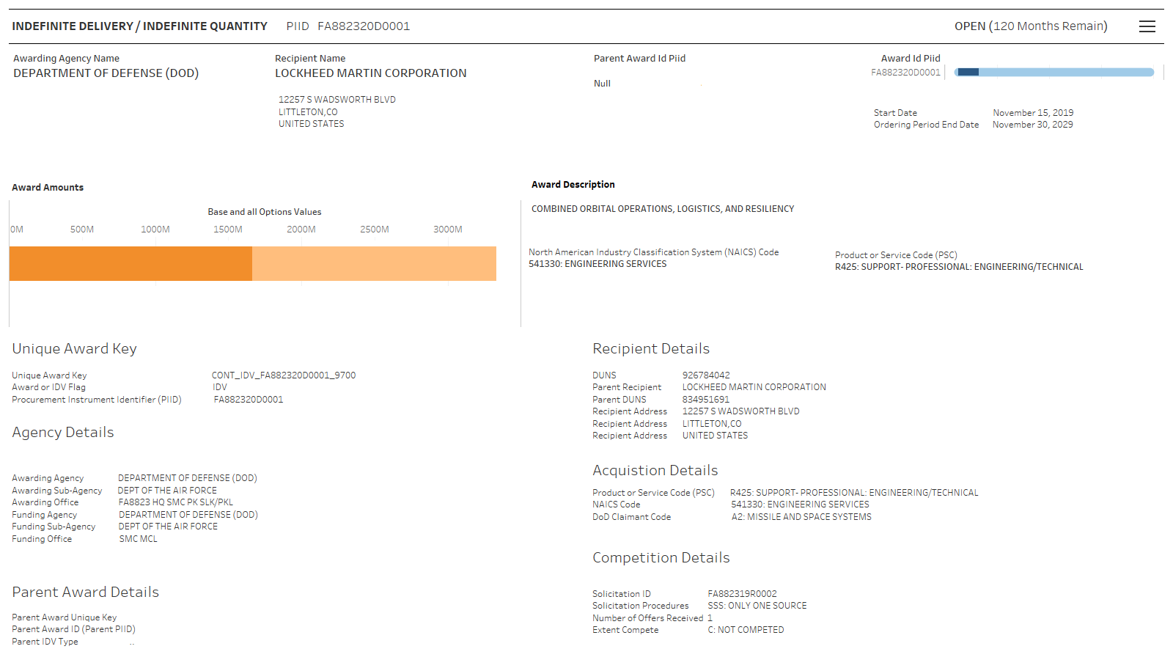
Solicitation/Award PIID
Procurement Instrument Identifier (PIID)
Solicitation PIID
Award PIID
Award Types
Definitive Contract
Indefinite Delivery/Indefinite Quantity (IDIQ)
Parent/Child Relationship
Hide/Show Collapsible Filter
Unique ID Drives Parent/Child Relationships
Relationships from Solicitation to Award

Slide 6
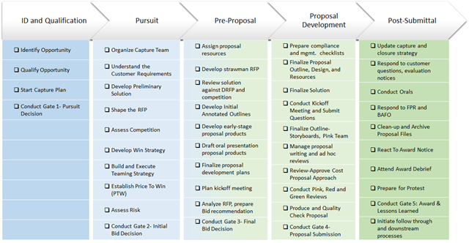
Business development: Shipley model
Shipley Model used for Capture Process
Phases and decision gates

Slide 7
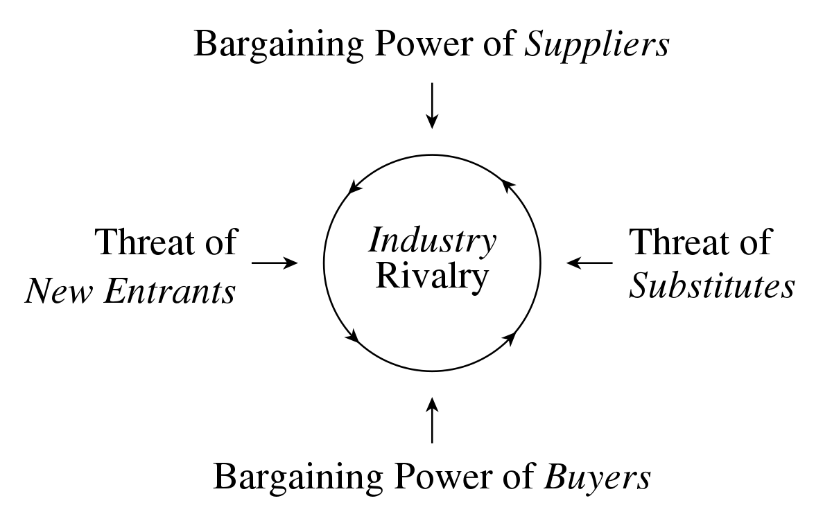
Competitive Intelligence
Identify the following:
Suppliers to awarding office
Subcontract awards recipients
Strategic partnerships

Slide 8
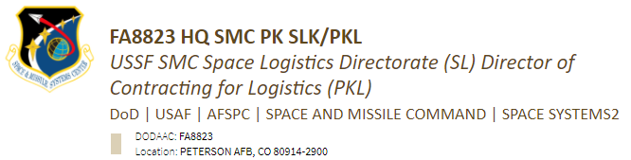
Account profiles
Create Account Profiles
Reporting Structure
Funding Office (Lead Management)
Contracting Office (Capture Management)
Microsoft Dynamics CRM
Account Profiles
Solicitations/Awards
Stakeholder Profiles
Track engagements

Slide 9
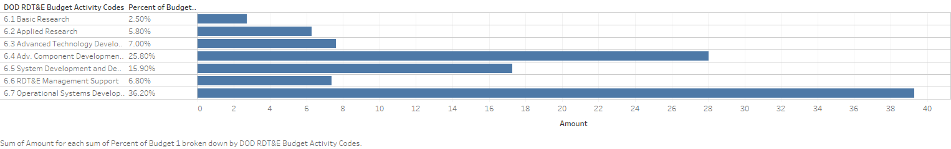
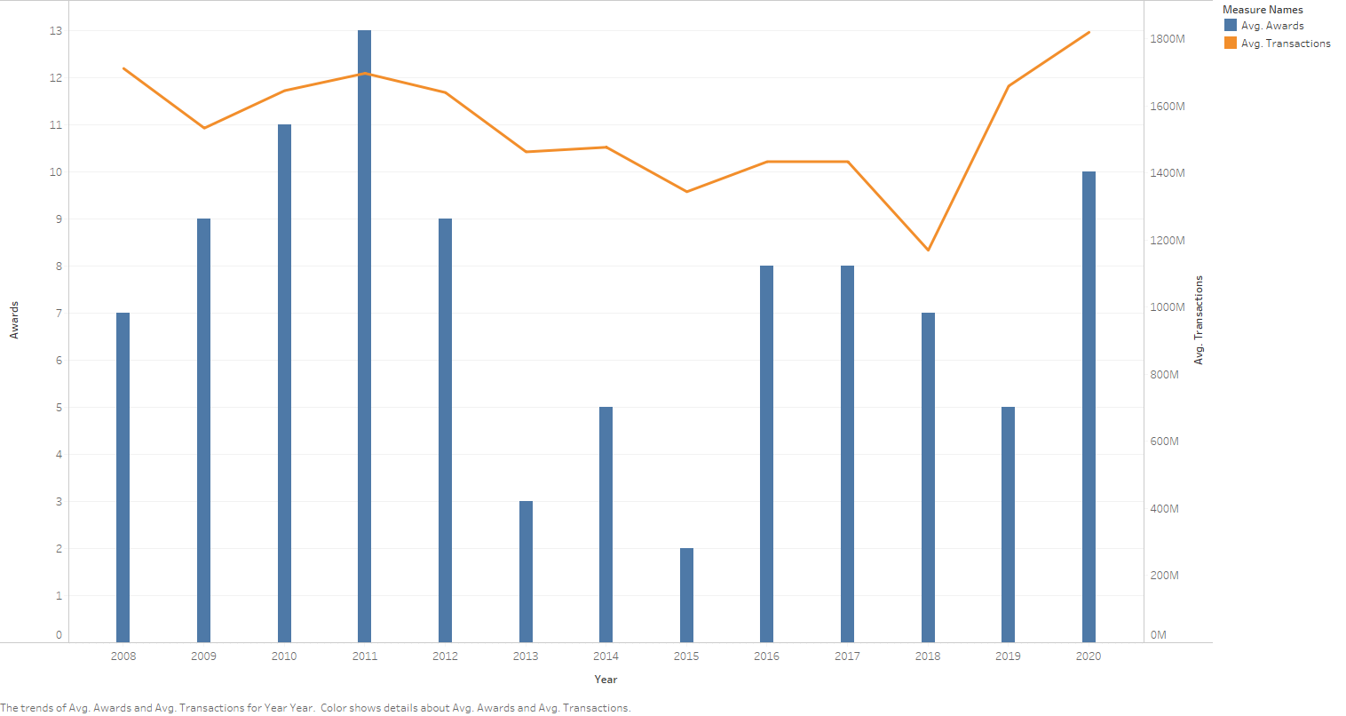
Account Portfolio
Track Budgets
Yearly Financial Budget by Office
Awarded Budget
Associate Awards to Awarding/Funding Office
Account Portfolios (Percentage of budget)

Slide 10
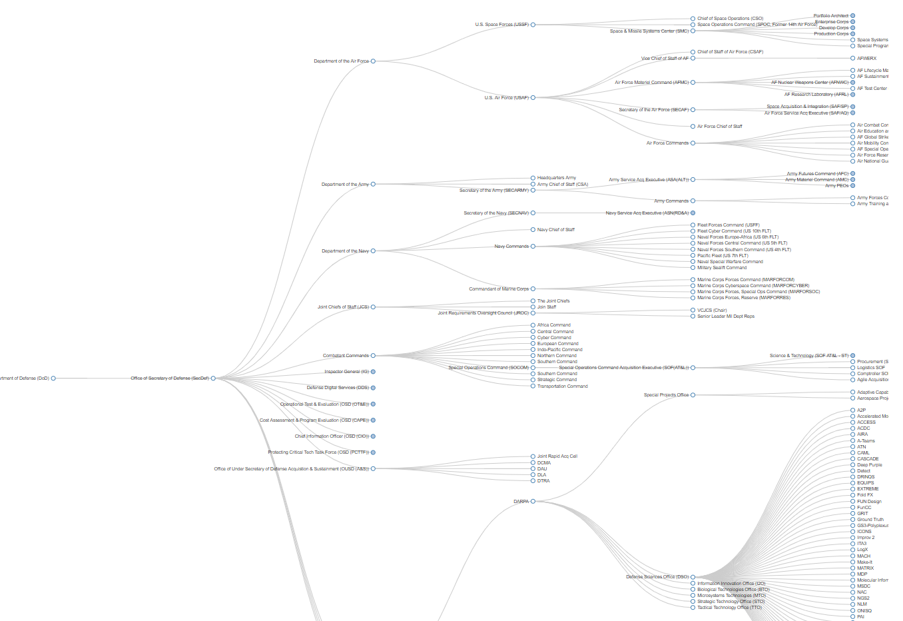
Department of Defense structure
Difficulties Defining DoD Customer Hierarchy
Organizations constantly reorganize
Changes may not be publicly announced
Consists of two types of offices:
Funding Offices
Awarding Offices
Interactive Collapsible Tree Diagram
Link

